Slide 1


Introduction to CUDA programming Comparison of C++ and CUDA Map Reduce
Andy Andrews

Slide 2
Overview
Description of CUDA
Simple CUDA Sample … vector dot product
Description of Map / Reduce operations
Looking at the code
Performance Comparison
Additional Resources

Slide 3

This talk
Will show two implementations of generic map-reduce functionality.
One in C++
The other in CUDA
Will use
Templates
Lambdas
Operator overloading
C-style arrays
Pointer arithmetic

Slide 4




GPU / CUDA Architecture

Slide 5

Description of CUDA
In this context CUDA is:
A language extension and bindings used to interface with Nvidia GPU hardware
A collection of libraries optimized for use on Nvidia GPU’s
A marketing term Nvidia uses to name its ecosystem of tools for programming its GPU hardware
What Is CUDA | NVIDIA Official Blog
For our purposes, it’s the language bindings for C++ we use to program Nvidia GPU’s
It employs a SIMD (single instruction multiple data) approach to parallelize workloads.
Same operation applied to multiple memory locations

Slide 6
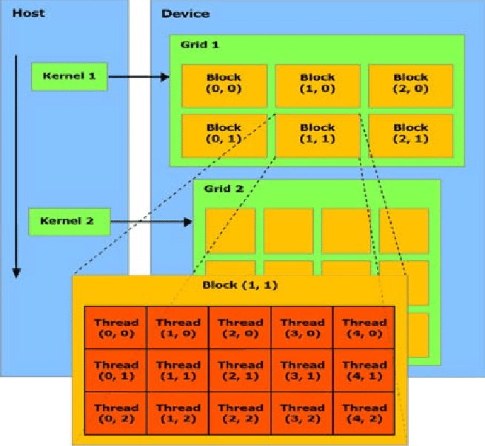
CUDA SIMD Processing Architecture
Thread – Single unit of work
Block – One or more partitions of available threads
Grid – One or more block running on a single GPU
Host – Machine where the GPU is installed… typically a general-purpose computer (e.g. X86-64, ARM, etc)
Device – GPU hardware
Kernel – Interface between host and device hardware

Slide 7
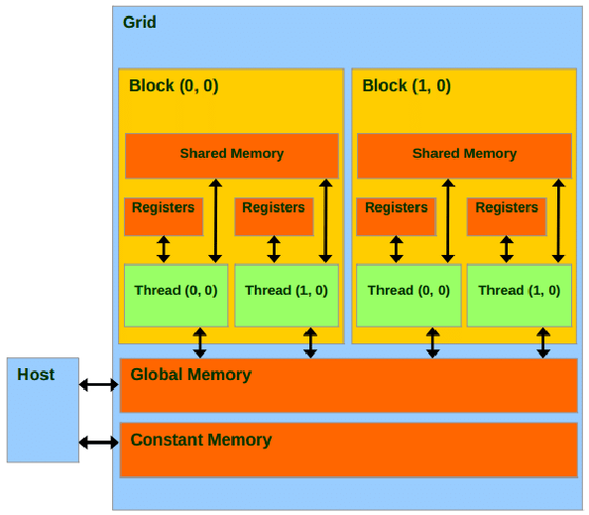
CUDA Memory Architecture
Register – Thread specific, high-speed memory
Shared – Shared across threads within a thread block
Constant – Available across thread blocks optimized for read operations
Global – Shared across multiple thread blocks… higher latency than other memory

Slide 8
CUDA Tools
nvcc – Nvidia CUDA Compiler
Available on Windows and Linux
Preprocessor which invokes the installed C or C++ compiler
Sometimes lags most recent version compiler
Libraries
cuBLAS – CUDA Basic Linear Algebra Subroutines
cuFFT – CUDA Fast Fourier Transform
cuRAND – Random number generators
Several others…

Slide 9

CUDA Typical Patterns of Use
Host side initialize
Initialize content on host
Allocate memory on kernel to perform operation
Copy host content to kernel
Perform operation on kernel
Copy results back to host
Deallocate memory on kernel used for operation
Device side initialization
Allocate memory on kernel
Initialize content on kernel
Perform operations on kernel
Copy results to host
Deallocate memory on kernel used for operation

Slide 10
Implications
Copying data to / from kernel is over PCIe bus
This increases latency since content must be:
Read from host RAM
Sent over PCIe bus
Written to device RAM
Operated on device
Read from device RAM
Sent back over PCIe bus
Written to host RAM
Does not fundamentally improve algorithmic time complexity
It improves the multiplier, though.
More hardware improves the multiplier more.
Technology | Transfer Rate
PCIe 4.0 x16 (2017) | 31.508 GB/s
PCIe 5.0 x16 (2019) | 63.015 GB/s
PCIe 6.0 x16 (2022) | 121.000 GB/s
PCIe 7.0 x16 (2025) | 242.000 GB/s
DDR4-3200 (2014) | 25.6 GB/s
DDR5-8400 (2020) | 64.0 GB/s

Slide 11
Basic CUDA Operations

Slide 12
CUDA Preprocessor
Device refers to the GPU hardware
Host refers to the host system
Symbol | Description | Example
__global__ | Designates code which runs on the device but called from the host. | __global__ void dbl(int size, int* u) { int idx = blockDim.x * blockIdx.x + threadIdx.x; if (idx < size) u[idx] *= 2; }
__device__ | Designates code or variables accessible on the device. | __device__ int d_val; __device__ int add(int x, int y) { return x + y; }
__host__ | Designates code variables accessible on the host | __host__ int d_val; __host__ int add(int x, int y) { return x + y; }

Slide 13
CUDA memory management functions
Functions are invoked on the host but affect memory on the device.
Function | Description | Example
cudaMalloc | Allocates device memory | int* val; int size = 10; cudaMalloc(&val, size*sizeof(int));
cudaMemcpy | Copies memory to / from device. | cudaMemcpy(d_dest, h_src, size*sizeof(float), cudaMemcoyHostToDevice); cudaMemcpy(d_dest, d_src, size*sizeof(float), cudaMemcoyDeviceToDevice); cudaMemcpy(h_dest, d_src, size*sizeof(float), cudaMemcoyDeviceToHost);
cudaFree | Deallocated device memory | cudaFree(val); Val – nullptr;

Slide 14
Calling a __global__ function from host
CUDA uses an “Execution Configuration” to define the resources
For our purposes, we will use it to define a number of processing blocks, each with a fixed number of threads.
Allows scaling the number of blocks needed for a given call.
__global__ void dbl(int size, int *d_res)
{
int idx = blockDim.x * blockIdx.x + threadIdx.x;
if (idx < size)
d_res[idx] *= 2;
}
dbl<<<NUM_BLOCKS, THREADS_PER_BLOCK>>>(size, dp);

Slide 15
Map, Reduce Approaches

Slide 16
CUDA Parallelism – Init / Map / Zip
Map operations considered
Each array element can be computed independently
Generate array content based on array index, elements of one or more other arrays
Special case… in general map operations are more general (e.g. FFT)
Initialize
Map
Zip

Slide 17

CUDA Parallelism - Reduce
Sequential Reduction
Result depends on all array elements
Reduce elements to a single value
E.g. sum the elements of an array
Approach used requires $\log_{2}\left(n\right)$ steps, each reducing elements pairwise each step.
Final step has 1 element which is the reduced result.
Parallel Reduction

Slide 18

Code Comparison
Dot product

Slide 19

Vector Dot Product
Used to see how one vector is projected onto another
Can be used to find the angle between two vectors
Let $\overset{⃑}{u},\overset{⃑}{v}∈ℝ^{n}$, the dot product of $\overset{⃑}{u}$ and $\overset{⃑}{v}$ is given by
$$\overset{⃑}{u}∙\overset{⃑}{v}=\sum_{i=0}^{n−1}{u_{i}v_{i}}$$
Perform an element-wise multiplication of each vector
Sum the products to compute the dot product.

Slide 20
C++
double dot(std::size_t size,
const double *u,
const double *v)
{
double sum = 0.0;
const double *pu = u;
const double *pv = v;
for (std::size_t i=0; i<size; ++i)
sum += (*pu++) * (*pv++);
return sum;
}

Slide 21
Performance Comparison
Dot product

Slide 22
Dot-Product Performance (Intel host)

Slide 23
Dot-Product Performance (AMD host)

Slide 24
Supplemental Information
Dot product

Slide 25
References
CUDA Toolkit Download – https://developer.nvidia.com/cuda-downloads (Windows, Linux)
CUDA Toolkit Download - https://developer.nvidia.com/nvidia-cuda-toolkit-developer-tools-mac-hosts (MacOS)
CUDA Official Documentation – https://docs.nvidia.com/cuda/cuda-toolkit-release-notes/index.html
CUDA Crash Course – https://www.youtube.com/playlist?list=PLxNPSjHT5qvtYRVdNN1yDcdSl39uHV_sU
Source code – https://github.com/hargrand/map_reduce

Slide 26

CUDA Compatible GPU Options
CUDA is NVIDIA proprietary
Workstation – NVIDIA RTX 6000 Ada
Consumer – NVIDIA GeForce RTX
Datacenter – NVIDIA A100
Embedded – NVIDIA RTX Embedded GPU

Slide 27

CUDA Alternative: OpenCL
OpenCL is an open standard for high performance programming across multiple technologies
Where CUDA is NVIDIA specific, OpenCL performs similar functionality across a variety of hardware architectures.
Website: https://www.khronos.org/opencl/

